Slide 1




ORAL
PRESENTATION
INTRODUCTION

Slide 2




WHAT IS ORAL PRESENTATION?
Oral presentations, also known as public speaking or simply presentations, consist of an individual or group verbally addressing an audience on a particular topic. The aim of this is to educate, inform, entertain or present an argument.

Slide 3
Purpose of oral presentation
In an academic setting, oral presentations are often assessable tasks with a marking criteria. Therefore, students are being evaluated on their capacity to speak and deliver relevant information within a set time-frame.
An oral presentation differs from a speech in that it usually has visual aids and may involve audience interaction; ideas are both shown and explained.

Slide 4







THE THREE STEP ORAL PRESENTATION
PLANNING
Oral presentation requires a great deal of Planning. At first, one should address their audience by focusing on how much the audience can understand
Organizing information in 3 to 5 points for maximum information retention
Building repetition as reminders for missed pointers

Slide 5
Introducing one is key to good oratory skills. Providing credibility and a powerful opening will interest your audience
Explain your points clearly while providing evidences. Use transitions between speech and your visual presentation along with analogies.
Signal your conclusion with a transition. Summarize and end with “Thank you”.

Slide 6
PRACTICE:
For the given topic plan a structured Presentation covering all its subtopics
Evolution of communication from letters to e-mail
01.
*talk about:
history of letters
inventions and innovations over the course
internet: web1, web2, www, coming of email

Slide 7

2. PRACTICING
Practicing is essential. Record yourself and figure out how to sound and appear before an audience
Practice before peers and elicit feedback. Ask your peers to comment on your delivery and content
The more you practice, the more confident you become. A polished delivery is a powerful delivery

Slide 8

3. PRESENTING
As a presenter, you should be able to make the audience comfortable and engaged with you
Maintain eye contact while briefly looking at your notes. Sweep your gaze across the room
Be aware of your body posture and maintain a smile.
Try to be slow and clear avoiding fumbling. Hand gestures are important too

Slide 9

Calibrate the volume of your voice so that your voice reaches the corners of the room
Avoid fillers like “uh”, “um”, “like” etc
Act as natural as possible, maintain your calm and dress appropriately

Slide 10






Shifting Trends in E-commerce
Traits of Leader
Paperbacks vs. e-Books
PRACTICE:
JUST-A- MINUTE
MAchine
Learning
NAtural Resources vs. Artificial Resources
Traps of adversiting

Slide 11


VISUAL AIDS
Visual aids help you to explain your points and act as a supporting evidence
Do not turn your back on your audience and try not to block your visual presentaion
Provide an orientation to the visual and highlight the points you want to focus on
Make your visuals appeasing and not to crammed up with information. Above all, it should augment with your speech

Slide 12

Q&A
In your planning, anticipate questions that your auidence might have:
Acknowledge the question. This polite gesture shows your interest and eagerness
Rephrase the question for your audience to hear and for you to answer in a way you want to. This will also give you time to figure out an answer
Answer the question clearly and concisely
Check with your audience if the answer is comprehensible

Slide 13



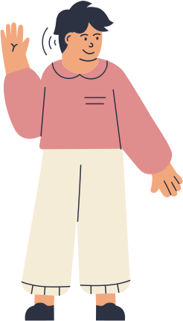
DO YOU HAVE ANY QUESTIONS?

Slide 14


THANK YOU!

